Slide 1

Department of Artificial Intelligence and Data Science
Real-Time Ingredient Recognition and Recipe Generator
Mrs.Y.Nirmala Anandhi
Sanjay B (221801045)
Soorya B (221801051)
Thofiq Gani M (221801057)

Slide 2
Introduction and Overview of the Project
Introduction:
This project develops a smart, real-time culinary assistant. It automatically identifies food ingredients from an image using advanced computer vision. The system then instantly generates a detailed and relevant cooking recipe. This dual-model approach aims to simplify meal planning and reduce food waste. It combines image detection with natural language processing for an intuitive user experience.
Overview of the Projects:
Ingredient Recognition: A YOLOv12 model detects and lists all visible ingredients from the input image in real-time.
Recipe Generation: The list of ingredients is passed to a BERT-based model.
Data Source: The BERT model uses a large CSV file containing structured recipe data for generation.
Process: The model predicts a complete, step-by-step recipe based on the provided ingredients.
Goal: To provide an instant, tailored recipe for users based on what they currently have.

Slide 3
Existing System
Manual Ingredient Input: Most apps require users to type ingredients manually, which is time-consuming and prone to errors.
No Real-Time Detection: Lack of live camera-based recognition, forcing users to search recipes separately after checking ingredients.
No AI-Powered Suggestions: Systems rely on keyword matching instead of smart, context-aware recipe recommendations.
Static Recipe Databases: Recipes are pre-defined, not dynamically generated based on detected ingredients, limiting flexibility.
No Waste Reduction Focus: Most platforms don’t prioritize expiring or leftover ingredients, missing sustainability opportunities.

Slide 4
Project Objective and Scopes
Project Objective:
To develop a real-time system for identifying food ingredients from an image.
To instantly generate a complete, functional cooking recipe based on the detected ingredients.
To simplify meal planning and reduce food waste by leveraging available ingredients.
To create a practical and accessible cooking assistant for all user skill levels.
Project Scope:
Computer Vision (CV): Implement and train a YOLOv12 model for real-time object detection of a defined set of common ingredients.
Natural Language Processing (NLP): Utilize and fine-tune a BERT-based model for sequence-to-text recipe generation.
Data: Recipe generation will rely exclusively on a pre-processed CSV file dataset.
Output: The system will generate a coherent, step-by-step recipe from the input ingredient list.
Deliverable: A functional proof-of-concept application demonstrating the end-to-end workflow.

Slide 5
Literature Survey
Title | Model(s) Used | Accuracy/Performance
Retrieval Augmented Recipe Generation | LLaVA (Large Language and Vision Assistant) with LoRA (Low-Rank Adaptation) | This model's performance was measured using common language generation metrics: a BLEU score of 30.11, a SacreBLEU score of 6.42, and a ROUGE-L score of 38.93 . These scores assess how closely the generated recipes match a set of reference recipes.
AI-Based Recipe Generator using GPT-4 | GPT-4 | The document does not provide specific accuracy or performance metrics for the GPT-4 model. It mentions that the system uses Natural Language Processing (NLP) for understanding user input to generate custom recipes
Masala Mamu : Agentic AI Kitchen Assistant | OpenAI GPT-4o and xal/grok-3-mini, microsoft/Phi-3.5-MoE-instruct | The system's performance was evaluated based on the specific tasks of each model. GPT-4o achieved an accuracy of 0.97 to 0.98 for vision and multimodal tasks. For recipe generation, bothxal/grok-3-mini and microsoft/Phi-3.5-MoE-instruct achieved a high accuracy of 0.99

Slide 6
Literature Survey
Title | Model(s) Used | Accuracy/Performance
Smart Chef AI: Recipe Generator and Recommander | Llama-2-7B-Chat (LLM) for generation and LSTM for recommendation | The paper states that an accuracy metric was used for the LSTM model, but the specific value is not mentioned in the document.
Comparative Analysis of GPT-2 and LSTM Models for Indian Recipe Generation | GPT-2 and LSTM | This paper provided a direct comparison. The fine-tuned GPT-2 model outperformed the LSTM model with a BLEU score of 0.852, a ROUGE-L of 0.785, and a lower perplexity of 12.50 . The LSTM model had significantly lower scores: a BLEU of 0.473, a ROUGE-L of 0.510, and a higher perplexity of 30.75
IndiFoodVQA: Advancing Visual Question Answering and Reasoning | Zero-Shot Models (mPLUG-Owl, OpenFlamingo, InstructBLIP, LLaVA) and a fine-tuned LLaVA model | In zero-shot performance, the InstructBLIP model achieved the highest accuracy at 54.15%. The fine-tuned LLaVA model demonstrated significant improvement, achieving ~69.22% without a knowledge graph and ~67.15% with 1-hop knowledge graph triples. The fine-tuning process resulted in approximately a 25% performance improvement over the base models

Slide 7
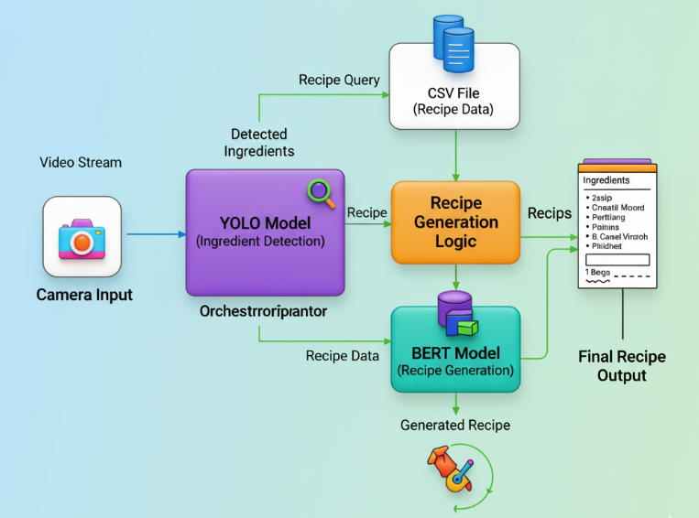
Architecture Diagram

Slide 8
Software Requirements Specifiction
Objective: Develop a system that identifies ingredients from an image and generates a recipe using a CSV file.
Key Components:
Computer Vision: YOLOv12-like model for real-time ingredient detection.
NLP: BERT model to process a recipe CSV file and generate a recipe.
User: This system is designed for home cooks and chefs who need quick, practical recipe ideas. It helps them find recipes by automatically identifying the ingredients they already have, saving them time and effort. Instead of searching endlessly, they get instant suggestions tailored to what's available.

Slide 9
Functional Requirements & Technology Stack
Functional Requirements:
Ingredient Recognition: Real-time detection of food items from an image feed.
Recipe Matching: Query a CSV file to find recipes containing the recognized ingredients.
Recipe Generation: Use a BERT model to format recipe data from the CSV into a readable recipe.
Technology:
Object Detection: YOLOv12-like model.
Recipe Generation: BERT model.
Data Source: Recipe CSV file.
Deployment: Cross-platform (e.g., Python on desktop/mobile).

Slide 10
Performance and Data Requirements
Performance:
Recognition Speed: Must be completed in under 2 seconds.
Generation Speed: Must be completed in under 1 second.
Data Requirements:
Recipe CSV: A well-structured file containing recipe details.
Model Weights: Pre-trained weights for YOLO and BERT models.
Training Data: Necessary for fine-tuning the models.
Constraints:
The system's recipes are limited to the provided CSV data.
The core functionality must work offline.

Slide 11
Reference
[1] P. Chhikara, D. Chaurasia, Y. Jiang, O. Masur, and F. Ilievski, "FIRE: Food Image to REcipe Generation," Proc. IEEE Winter Conf. on Applications of Computer Vision (WACV), 2024, pp. 1234–1245.
[2] Y. Yin, H. Qi, B. Zhu, J. Chen, Y.-G. Jiang, and C.-W. Ngo, "FoodLMM: A Versatile Food Assistant using Large Multi‑modal Model," arXiv preprint arXiv:2312.14991, 2023.
[3] K. Fu and Y. Dai, "Recognizing Multiple Ingredients in Food Images Using a Single‑Ingredient Classification Model," arXiv preprint arXiv:2401.14579, 2024.
[4] H. Qi, B. Zhu, C.-W. Ngo, J. Chen, and E.-P. Lim, "Advancing Food Nutrition Estimation via Visual‑Ingredient Feature Fusion (VIF²)," Proc. ACM Int. Conf. on Multimedia Retrieval (ICMR), 2025.
[5] T. Senath et al., "Large Language Models for Ingredient Substitution in Food Recipes using Supervised Fine‑tuning and DPO," arXiv preprint arXiv:2412.04922, 2024.
J. Louro, F. Fidalgo, and Â. Oliveira, "Recognition of Food Ingredients—Dataset Analysis," Appl. Sci., vol. 14, no. 5, pp. 2356, 2024.

Slide 12
Reference
A. Mane, G. Sharma, A. Soraganvi, A. Devkar, and R. Raut, "Food Ingredient Detection Using Deep Learning," Proc. SIPCOV 2023, 2024, pp. 12–19.
[8] M. Banjade, R. Chhetri, and P. Sharma, "Deep Learning and Gen AI based System for Ingredient Recognition and Recipe Insight," Int. J. Sci. Eng. Technol., vol. 12, no. 6, pp. 878–886, 2024.
[9] V. G. Bharane et al., "Recipe Reveal – Ingredients and Recipe Generation from Food Image," Int. J. Adv. Comput. Eng. & Comp. Tech., 2025, pp. 539–550.
[10] A. Shokeen, R. Sharma, and S. Verma, "Recipe Generation from Food Images Using CNN," Int. J. Innovative Res. in Technol., 2025, pp. 1–8.

Slide 13
Thank You

